Slide 1

COVID-19 Pandemic and its Impact on Air Travel
February 24, 2022
Notes:
Greetings - Jeanie

Slide 2




Team Introduction
Pooja Mahajan,
Data Scientist, Los Angeles
Robert Harvey,
Enterprise Tech, Los Angeles
Jeanie Wu,
Data Scientist, Los Angeles
Ismael Rodriguez,
Data Scientist, Los Angeles
Notes:
Quick introductions - all

Slide 3
Data Sources
Data on COVID-19 (coronavirus) by Our World in Data
Air Flight Data by Kaggle.com (author: Rajkumar Sengottuvel)
(Source website: https://www.kaggle.com/rajsengo/sfo-air-traffic-passenger-and-cargo-statistics?select=Air_Traffic_Passenger_Statistics.csv)
Notes:
Jeanie

Slide 4
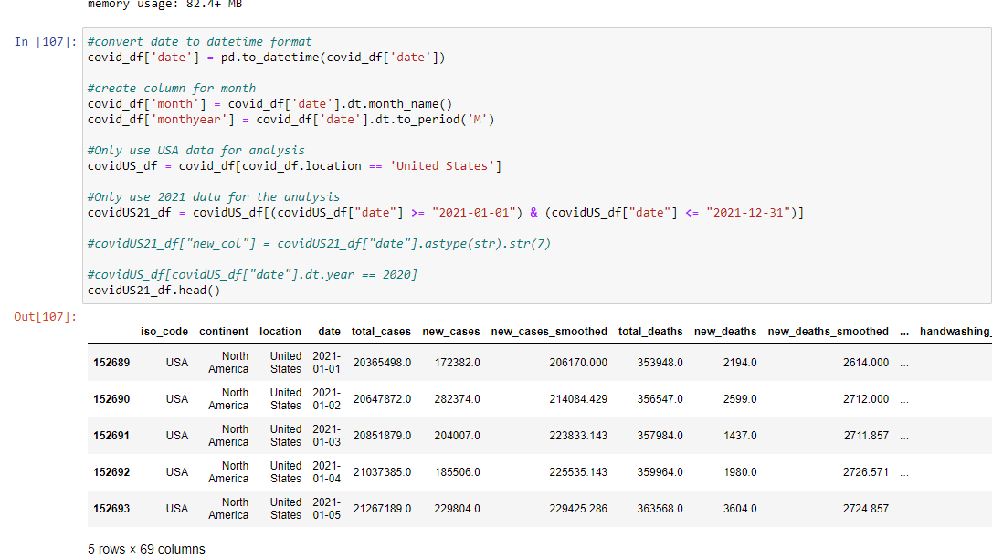
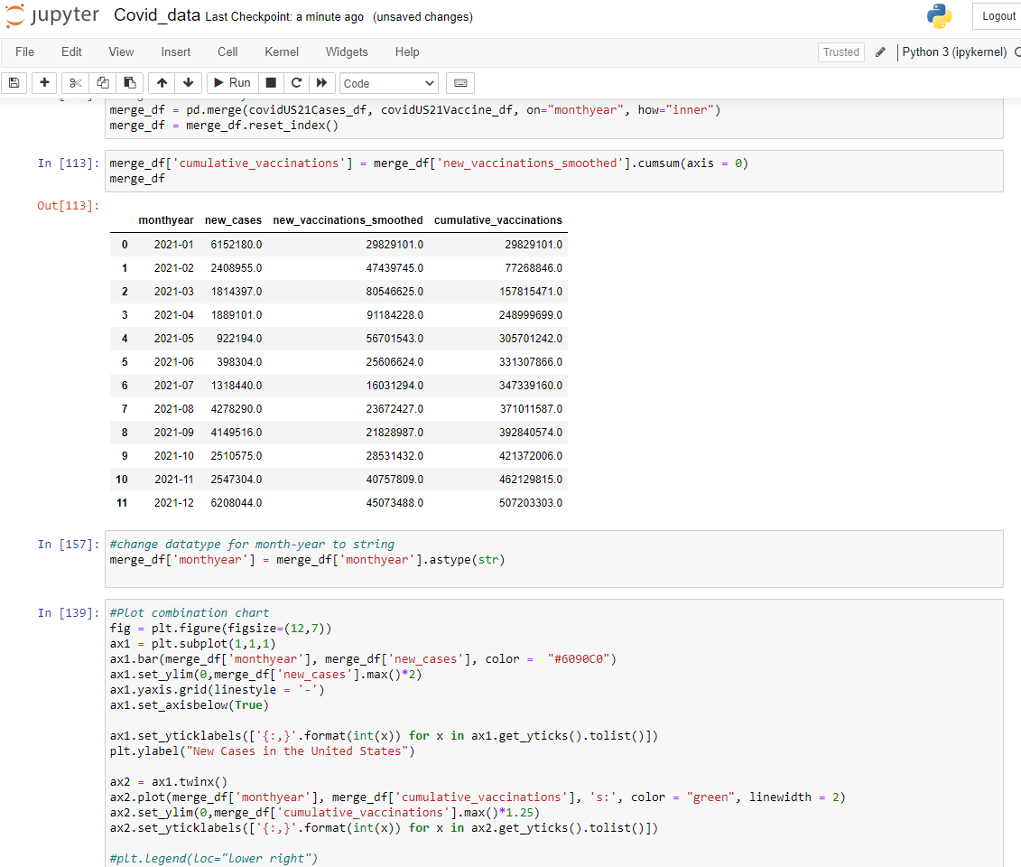
Exploratory Data Analysis - COVID-19 data
Notes:
Pooja

Slide 5
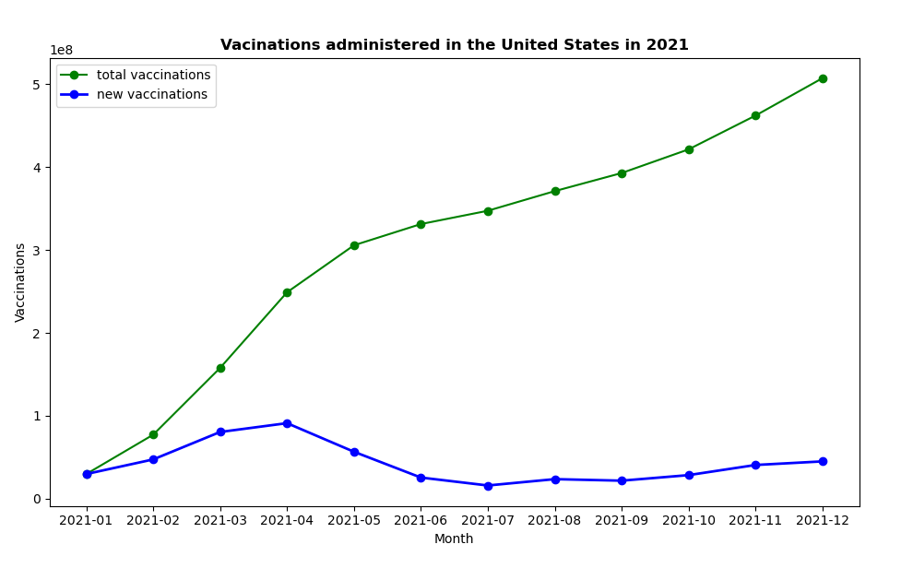
Over 500M COVID-19 vaccinations were administered in the United States in 2021
Key Takeaways
As the vaccine became readily available to adults in the United States there was a sharp increase in the total vaccinations administered, particularly in the first quarter of 2021
By first half of 2021, over 300M vaccinations were administered, suggesting that approx. 50% (150M) of US population had received the vaccine
Total vaccines administered in the second half of 2021 remained consistent as majority of the US population had received at least 1 vaccine dose
Notes:
Pooja

Slide 6
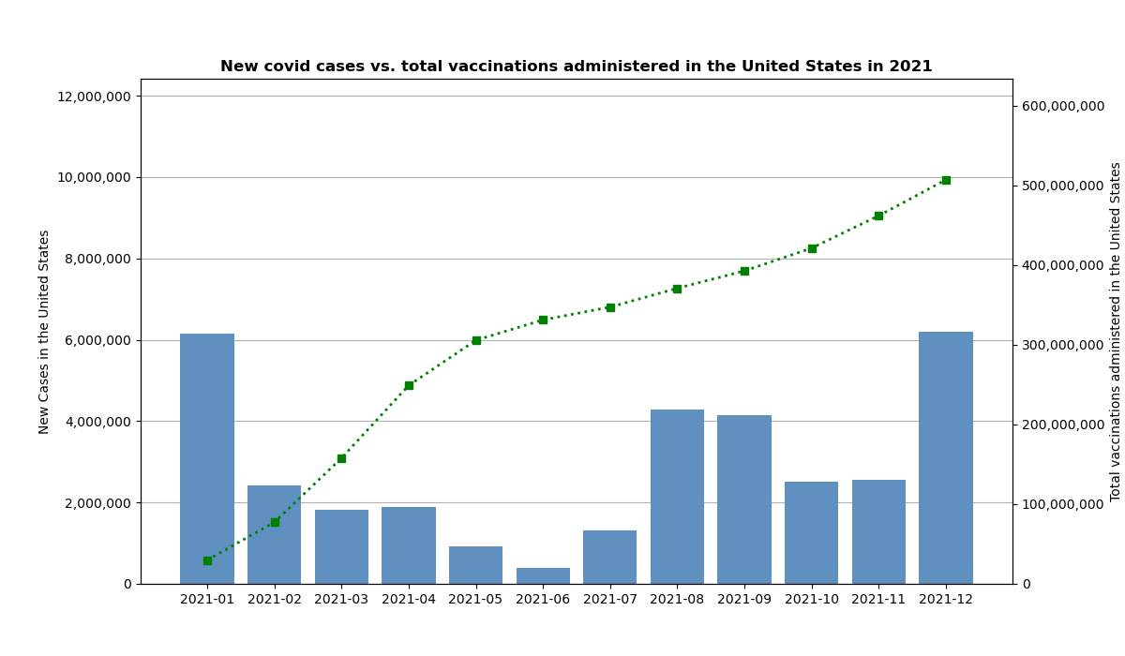
Despite increase in vaccinations, total cases were 60% higher in the second half of 2021 compared to the first half
Key Takeaways
A quick decline in new COVID-19 cases was observed from Jan to June. This may be attributed to rapid adoption of the vaccines among adults
21M cases were recorded from Jun-Dec compared to 13M recorded between Jan-June. The increase may be attributed to coronavirus variants
The total cases at the end of 2021 were approximately the same as the beginning
Notes:
Pooja

Slide 7
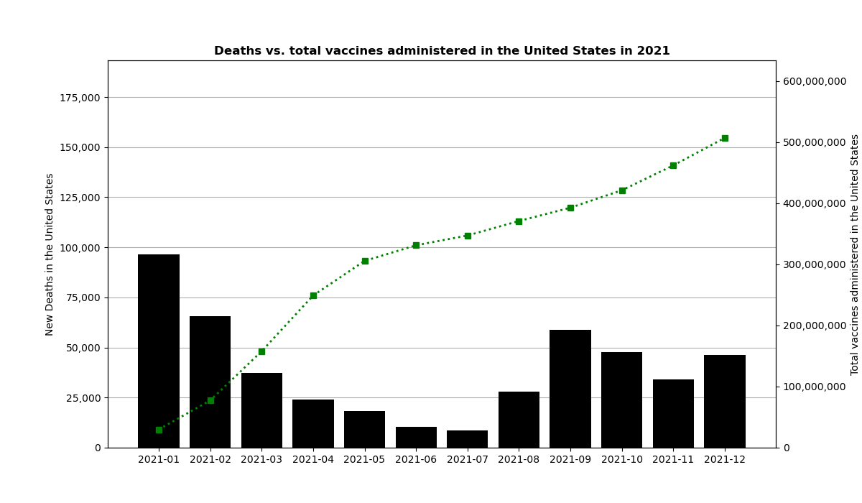
But vaccinations proved effective in reducing the risk of death by COVID-19
Key Takeaways
Overall, the number of deaths due to COVID-19 reduced as more people received vaccinations.
Lowest death count was observed in June and July, right around the same time rate of vaccinations peaked in the United States
Despite an increase in the cases in the second half of 2021, the death rate reduced significantly as a result increased protection against hospitalization and fatalities from vaccinations
Notes:
Pooja

Slide 8
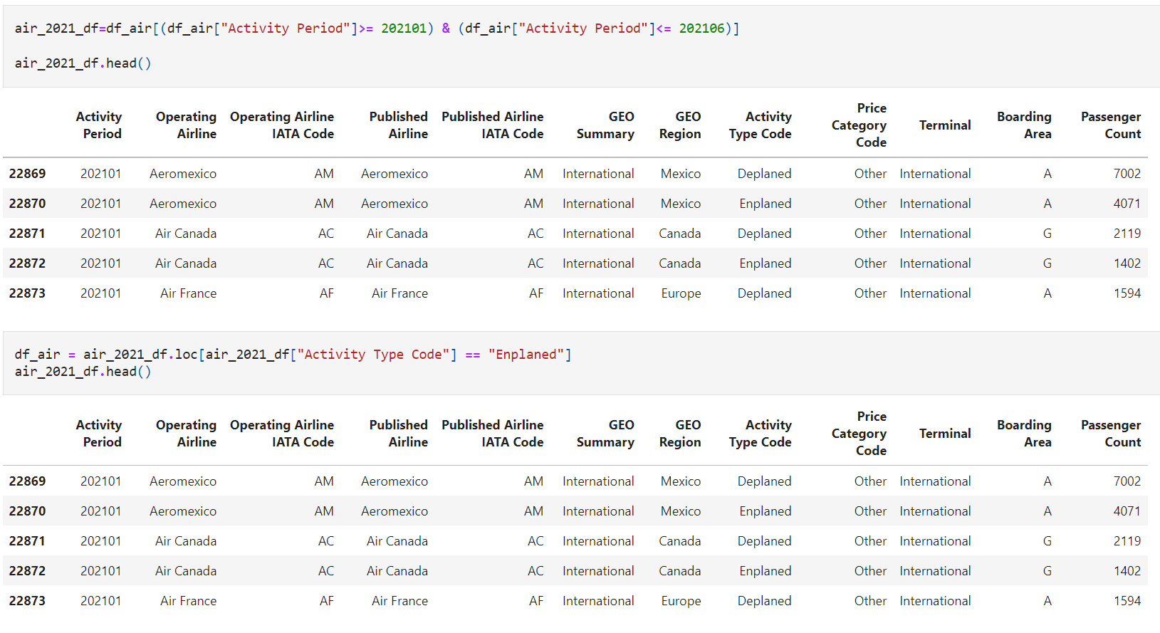
Exploratory Data Analysis – SFO Flights data
Notes:
Robert

Slide 9
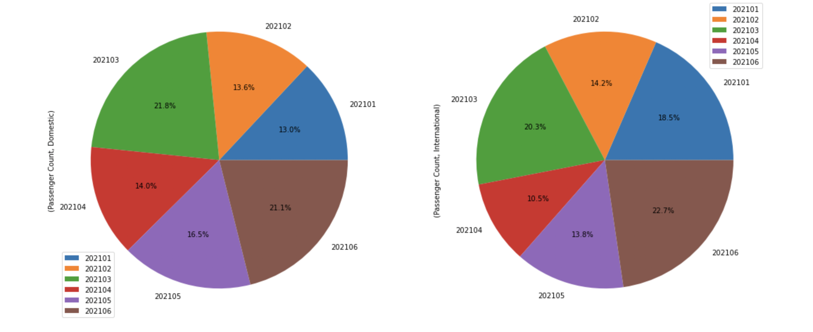
Domestic air travel increased as COVID-19 Cases declined in first half of 2021
Key Takeaways
June had the highest number of international flights
March had the highest number of domestic flights
A decline in the international flights was observed from April-May, likely due to travel restrictions and lockdowns implemented by countries across the world
Notes:
Robert

Slide 10
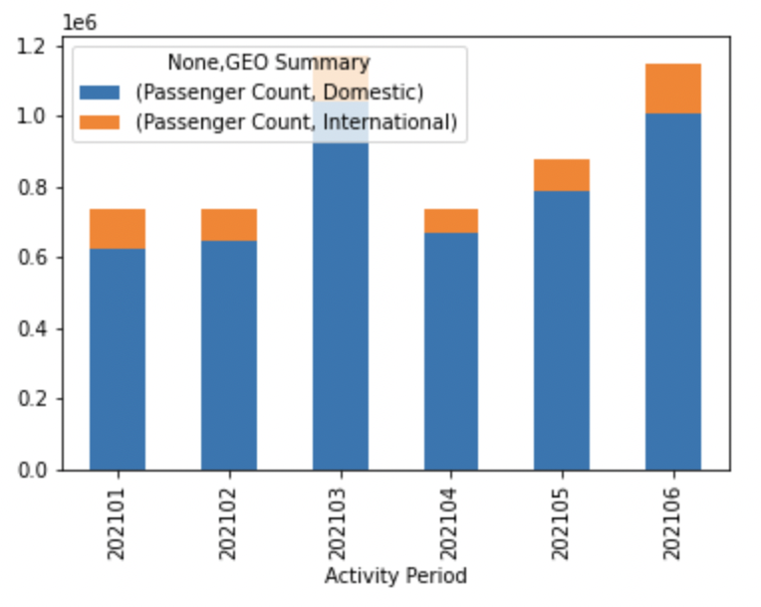
Domestic air travel increased as COVID-19 Cases declined in first half of 2021
Key Takeaways
International flights have fewer passengers than domestic flights
In April, the international flight decreased
Notes:
Robert

Slide 11
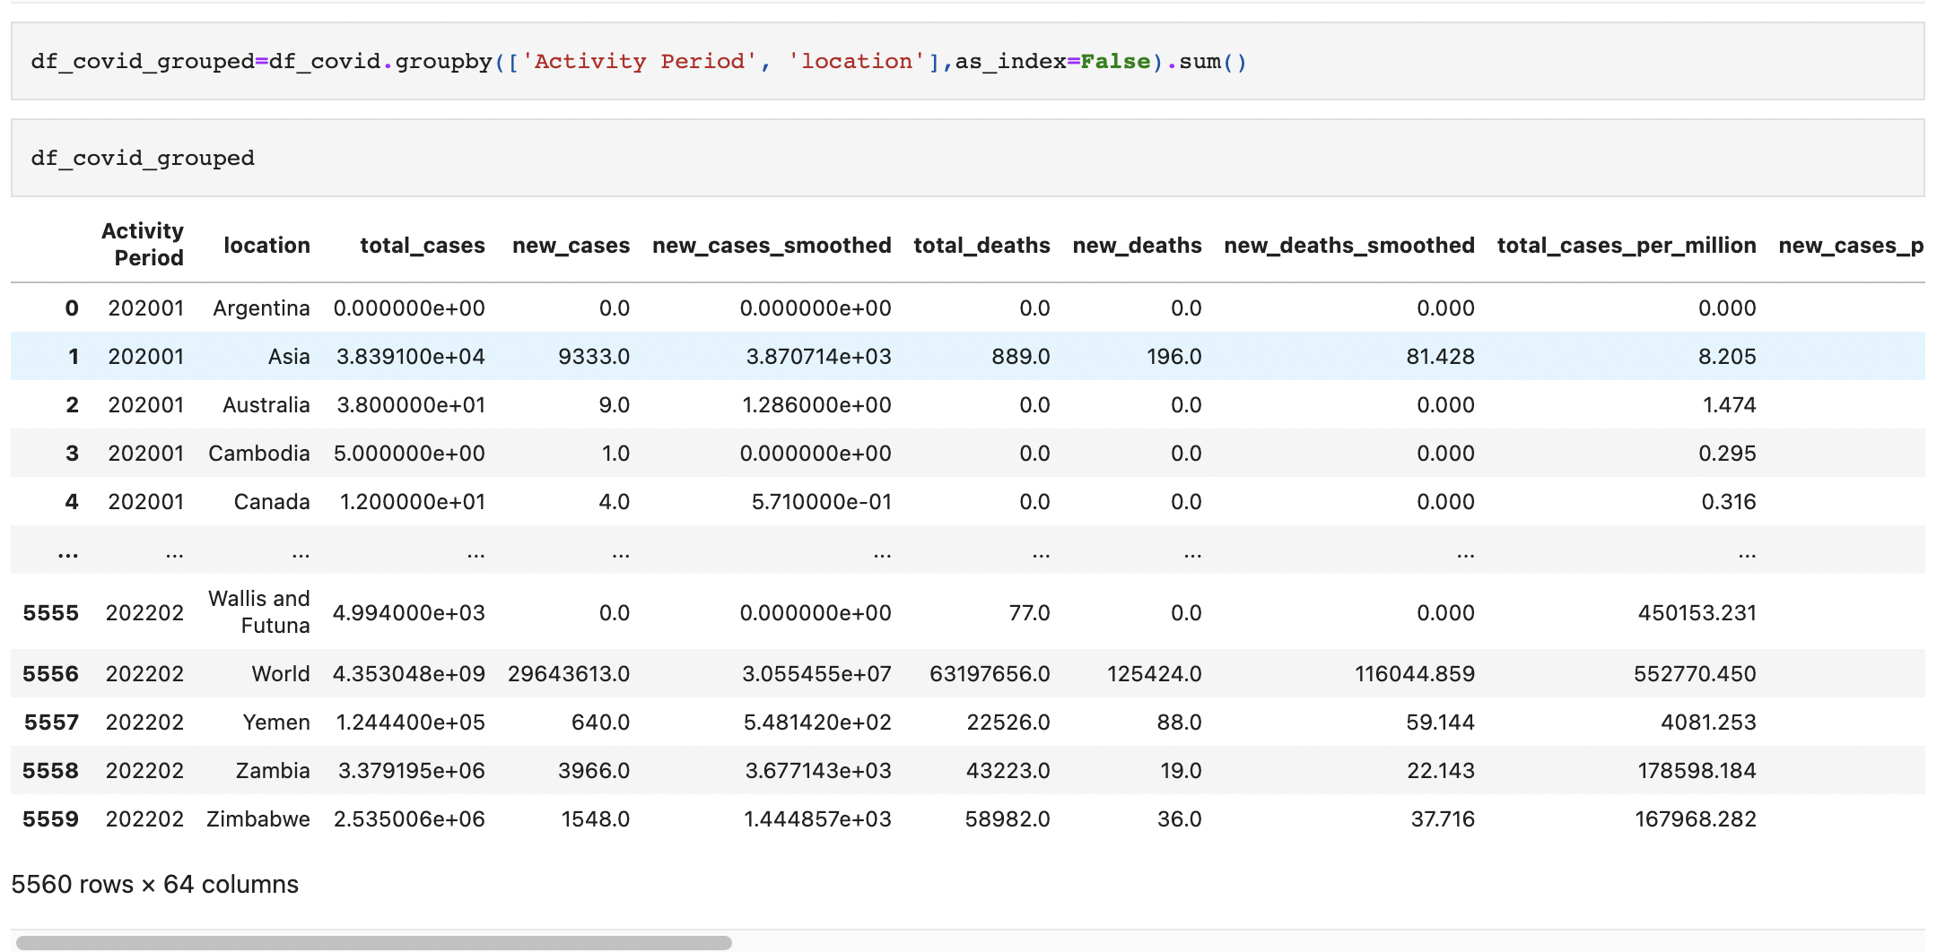
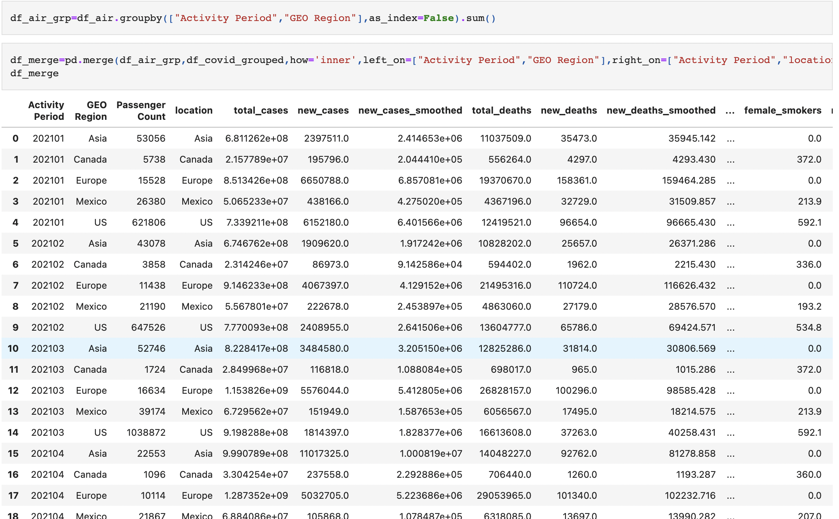
Exploratory Data Analysis – COVID-19 and SFO Flights data
Notes:
Jeanie

Slide 12
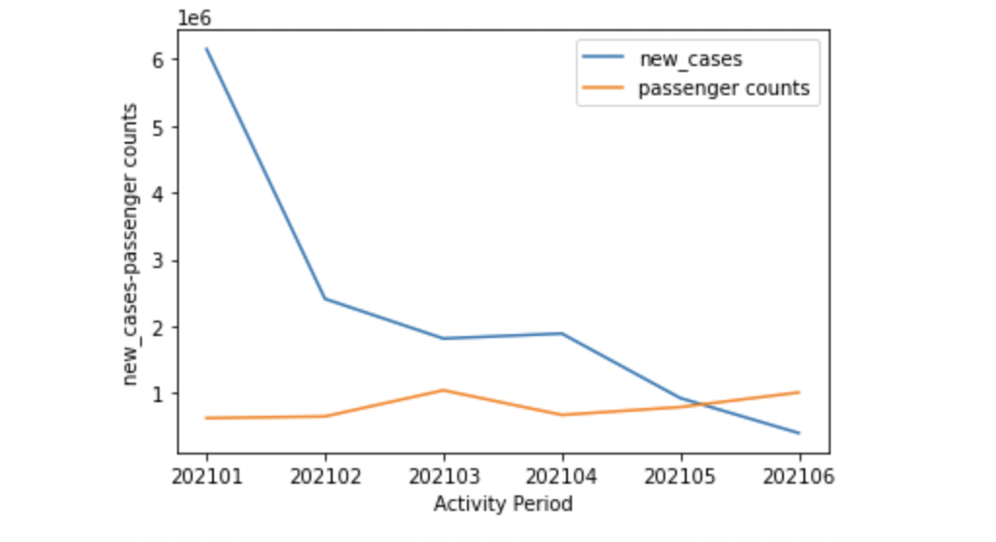
The airline industry experienced a growth in domestic and international travelers during the first half of 2021
Key Takeaways
The new cases decreased in 2021 from January to June, and the number of passengers flying started increasing at this time
In May, passenger flying number exceed new cases
Notes:
Jeanie

Slide 13
Findings
Total of 500M vaccine doses were administered in 2021 in the United State with 60% administered in the first quarter alone. This resulted in a sharp decline in recorded COVID cases in the first half of 2021, with lowest recorded cases between Jun-Jul
Despite the steady increase in the vaccinations, the country experienced an increase in the cases by 60% from Jul-Dec compared to the first half of the year. The rise can be attributed to variants of the novel coronavirus
Vaccinations proved highly effective in reducing risks of hospitalization and deaths and significantly reduced the death toll in the second half of 2021, despite the rise in cases
Domestic air travel increased from 13% in Jan to 21% in June from the SFO airport due to the decline in covid cases
There were no discernable trends observed with respect to the international flights and can be attributed to the varying travel restrictions and quarantine policies implemented by different countries.
Notes:
Ismael

Slide 14
Data Limitations
We found that our original dataset was limited in that we only have data from one airport, SFO
Our dataset was also limited to 6 months of flight data, from January to June, 2021
The COVID-19 data was not broken down by states or cities, making it challenging to compare and analyze COVID cases with flight data
The data is static (csv files) and therefore becomes obsolete and old very quickly. Using APIs would enable using live data to analyze
Notes:
Ismael

Slide 15
Q&A and Thank you!
Notes:
All

